Slide 1








LOAN PREDICTION
PROJECT BY :
ASMA BATOOL
NAVYA VEMURI
SHUBHAM K PAWAR
MUKESH LAUDYA
PYTHON PROGRAMMING:
PROFESSOR KALEEMUNNISA

Slide 2









AGENDA
INTRODUCTION
PROBLEM DEFINITION
VIZUALIZATION
RESULT
MODELING
CONCLUSION

Slide 3


INTRODUCTION
The Loan Prediction System offers the applicant's loan application an interface for loan approval. The system receives the applicant's personal information and uses it to decide whether or not a loan is appropriate for them.
To decide whether or not, a loan application should be granted, loan prediction analysis analyzes specified parameters. Loans that have been approved typically have a solid credit history, respectable application income, and dependability in other areas.

Slide 4


PROBLEM DEFINITION
The business will be automated according to the loan eligibility process using the information customers supply on the online application form. These information include the following: Gender, Marital Status, Education, Dependents, Income, Loan Amount, Credit History, and Other. we've created a challenge to help them identify the client categories that are eligible for loan amounts in order to automate this procedure and target these customers in particular.
Develop the ML models that can help to predict loan approval in accelerating-decision making process for determining weather an applicant is eligible for loan or not.

Slide 5

OBJECTIVES
•Loaded Data
•Check Data Columns
Created user library
•Drop NULL Values
•Drop duplicates
•Box Plot
•Histogram
•Heat Map
•Scatter plot

Slide 6
OBJECTIVES
Count plot
Bar plot
Created logistic regression model
Created SVCMODEL
Compared logistic regression and SVCM using ROC curve
Created pickle files for deployment
Using Pycham ->Flask Library deployed the model on the local host

Slide 7
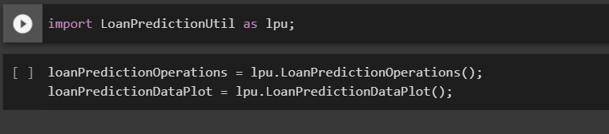
UTILITY PACKAGE

Slide 8
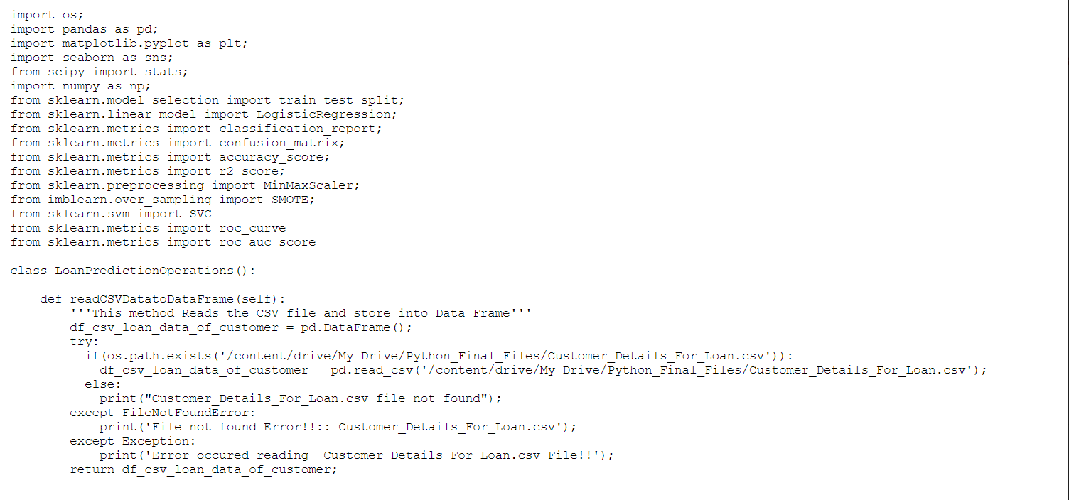
LOAN PREDICTION UTILITY PACKAGE

Slide 9
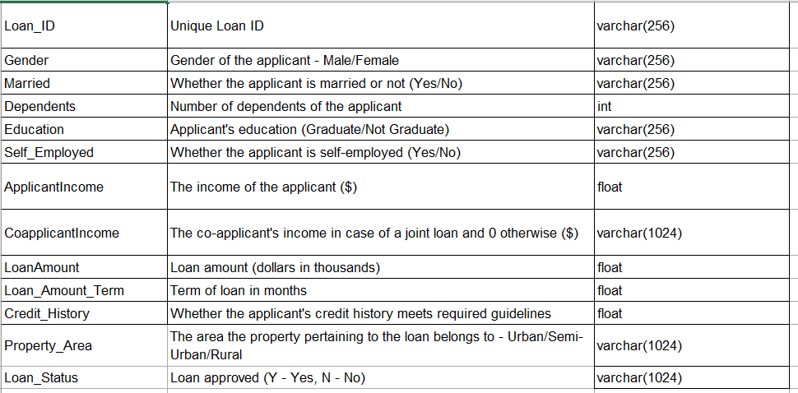
DATA DICTIONARY

Slide 10
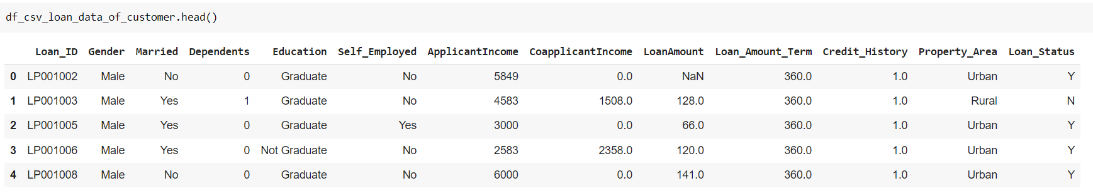
DATA SET

Slide 11
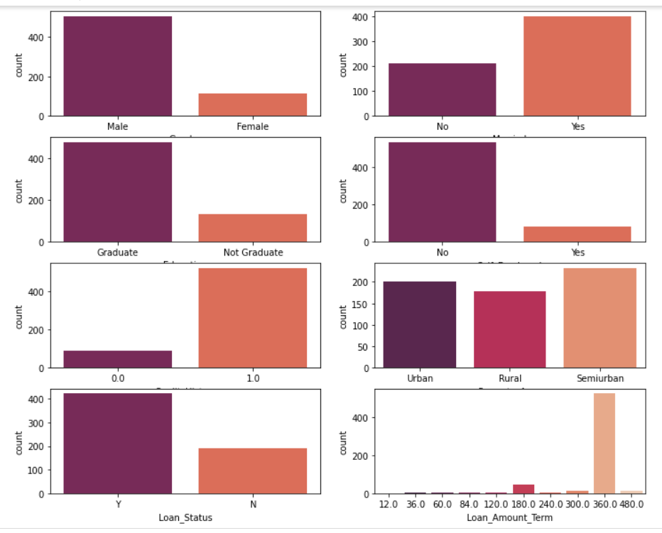
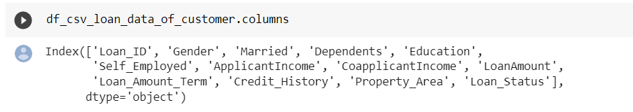
COLUMNS

Slide 12
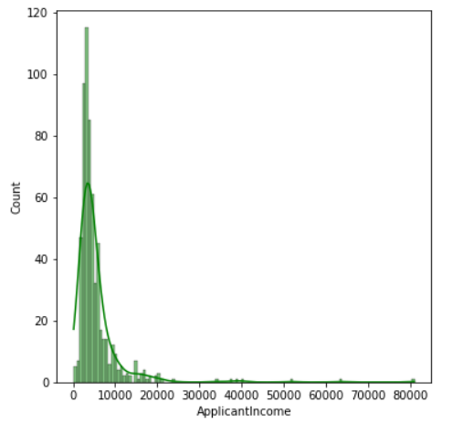
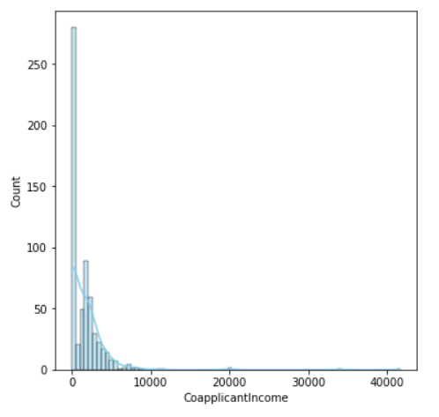
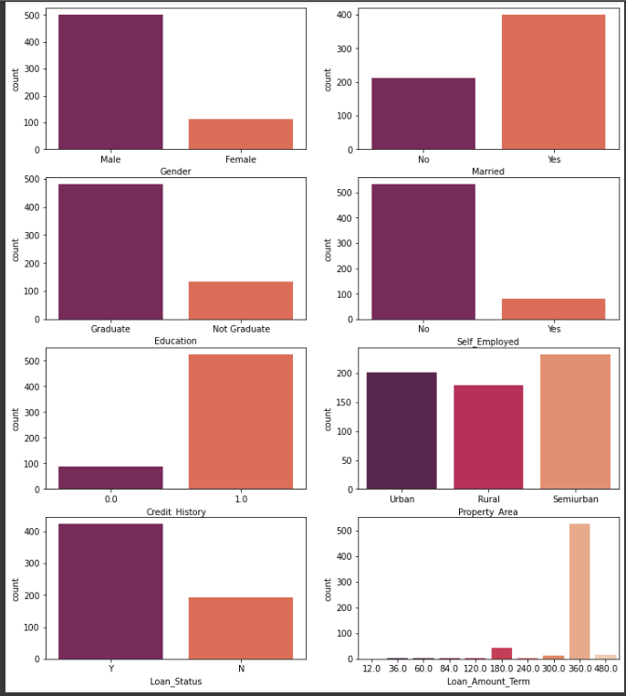
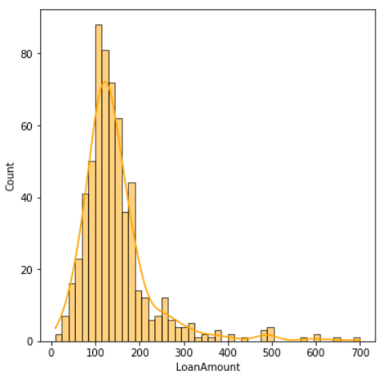
VISUALIZATION AND RESULTS
>>The number of male applicants is higher compared to female applicants.
>>The number of applicants that has been married is higher compared to applicants that hasn't married.
>>The number of applicants that has been graduated is higher compared to applicants that hasn't graduated.
>>The number of applicants that are not self employed is higher compared to applicants that are self employed.
>>The number of applicants that have good credit history is higher compared to applicants that have bad credit history.
>>This column has a balanced distribution between Urban, Rural, and Semiurban property area.
>>The number of approved loans is higher compared to rejected loans .
>>As can be seen from the results, the 360 days loan duration is the most popular compared to others.

Slide 13
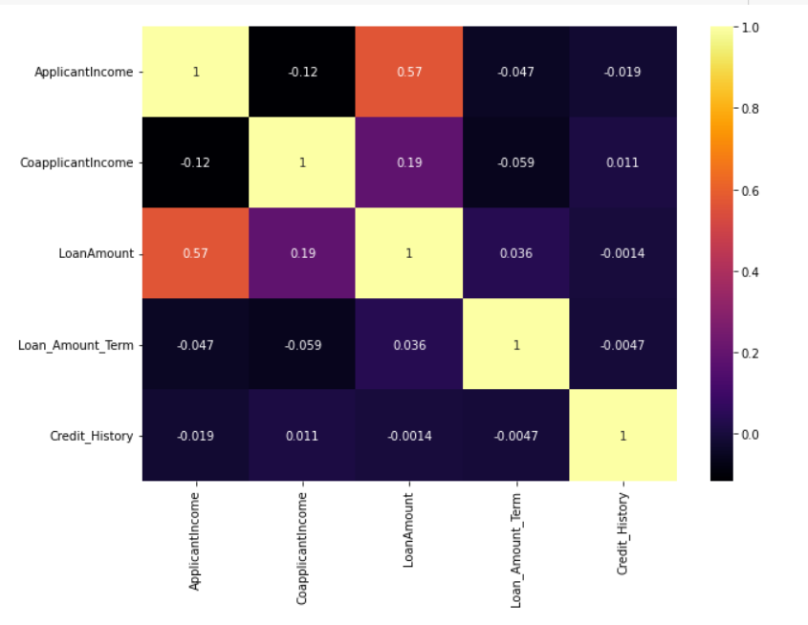
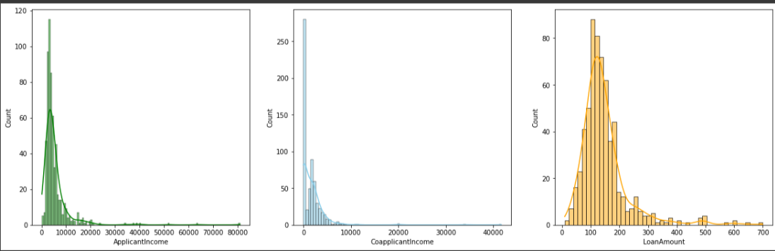
HISTOGRAM PLOT
>>From the above histogram plots we can see that, the distribution of Applicant income, Co Applicant Income, and Loan Amount are positively skewed and it has outliers.

Slide 14
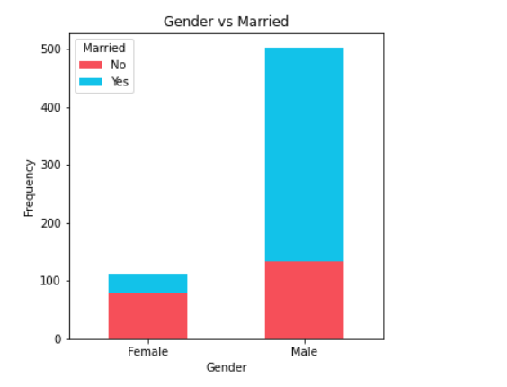
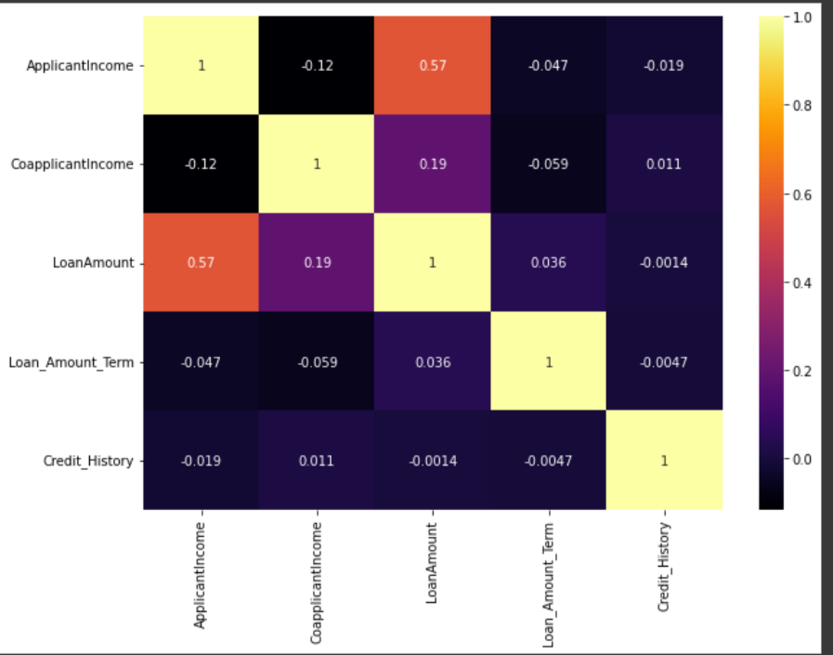
HEAT MAP
>>From the above heatmap we can see that, There is positive correlation between Loan Amount and Applicant Income

Slide 15
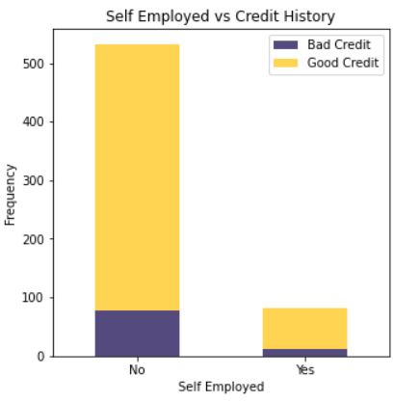
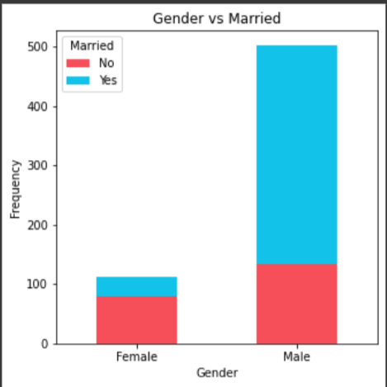
BAR PLOT
Most male applicants are already married compared to female applicants. Also, the number of not married male applicants are higher compare to female applicants that had not married.

Slide 16
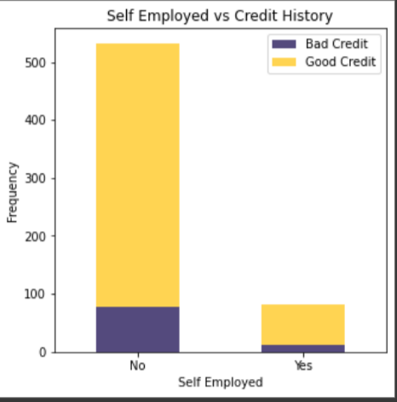
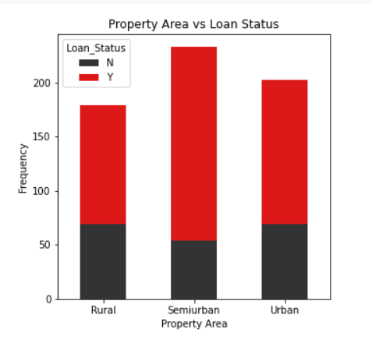
BAR PLOT
#Most not self employed applicants have good credit compared to self employed applicants.

Slide 17
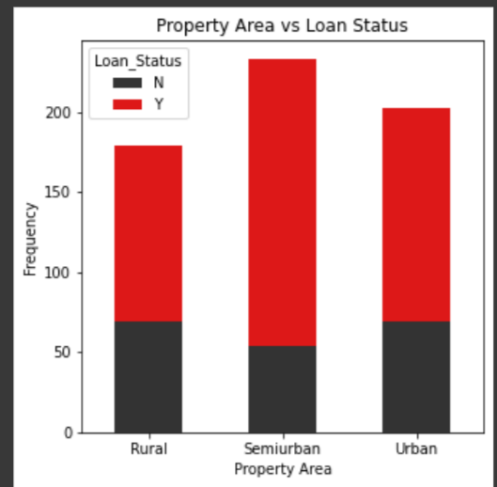
BAR PLOT
Most of loan that got accepted has property in Semiurban compared to Urban and Rural
.

Slide 18
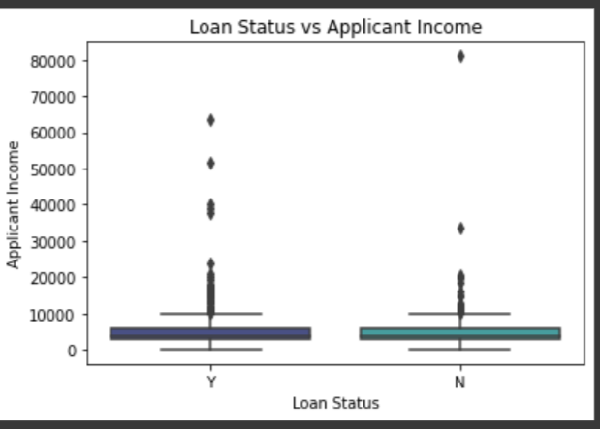
BOX PLOT
>>It can be seen that there are lots of outliers in Applicant Income, and the distribution
also positively skewed

Slide 19
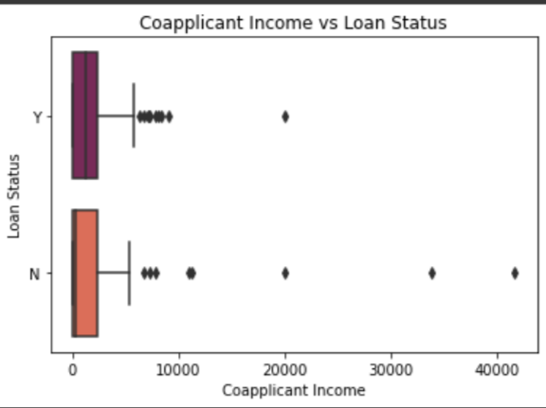
BOX PLOT
It's clear that Co Applicant Income has a number of outliers, and the distribution is also positively skewed.

Slide 20
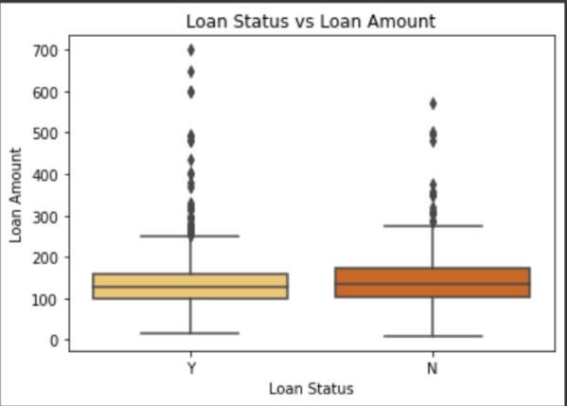
BOX PLOT
>>As can be seen, LoanAmount has a high number of outliers, and the distribution is also positively skewed.

Slide 21
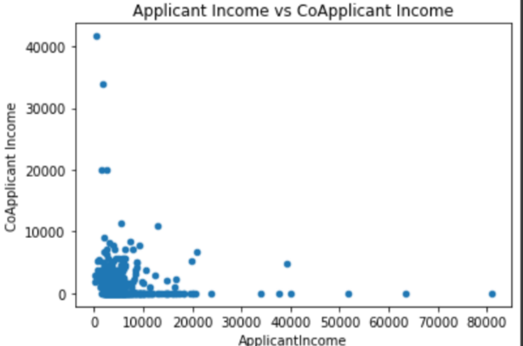
SCATTER PLOT
>>There is negative correlation between Applicant income and Co Applicant Income.

Slide 22
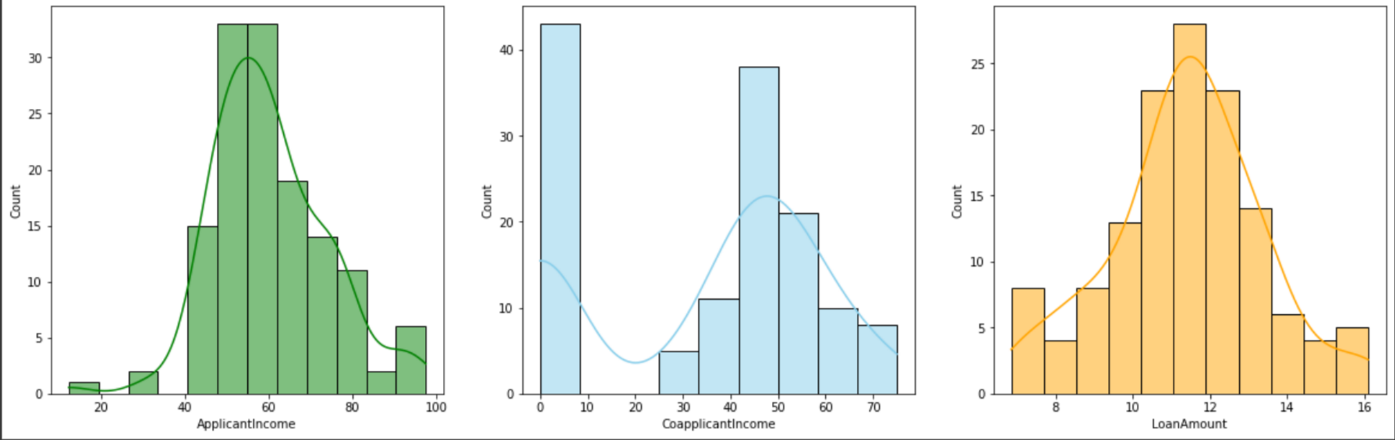
HISTOGRAM
As can be seen, the distribution after using log transformation are much better compared to original distribution.

Slide 23
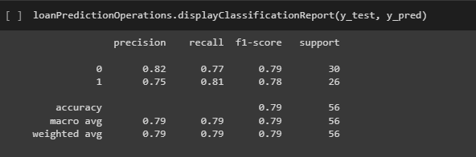
LOGISTIC REGRESSION MODEL
It is a classification set of rules used to assign observations to a discrete set of instructions. Logistic regression is also a predictive analysis, like other regression analyses methods. Logistic regression is basically used for define the relationship between dependent binary variable and nominal or other independent variable. Now a days logistic regression is used in many research areas like medical science, machine learning and social science. It also used by many e-commerce applications to predict the mind set of customer to buy the product

Slide 24
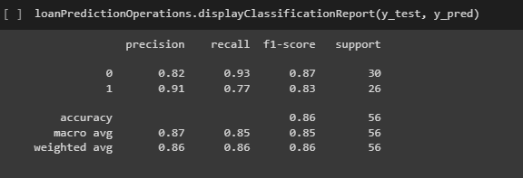
SUPPORT VECTOR CLASSIFIED MODEL
SVM is a well known Supervised Machine Learning algorithm. Currently, the SVM classifier is the most common classifier 1.SVM has demonstrated a wide range of exceptional abilities, particularly in classification problems.
2.In this each data item is plotted in
n-dimensional space

Slide 25
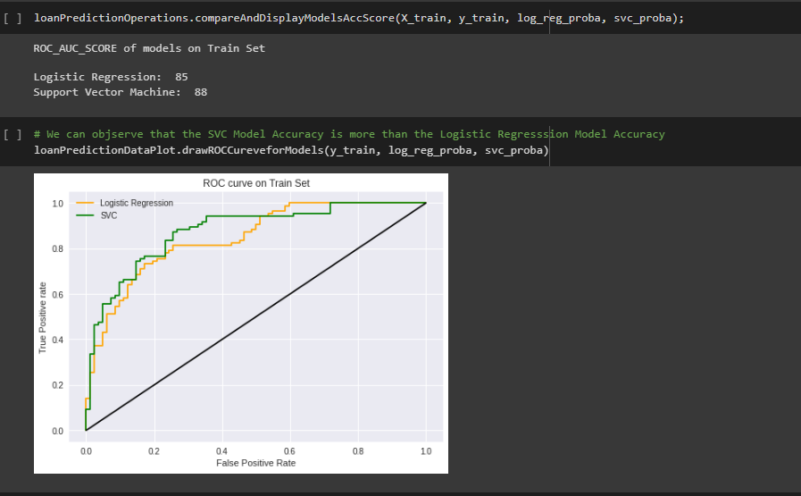
COMPARISON BETWEEN LOGISTIC AND SVM MODEL
We can observe that the SVC Model Accuracy is more than the Logistic
Regression Model Accuracy

Slide 26
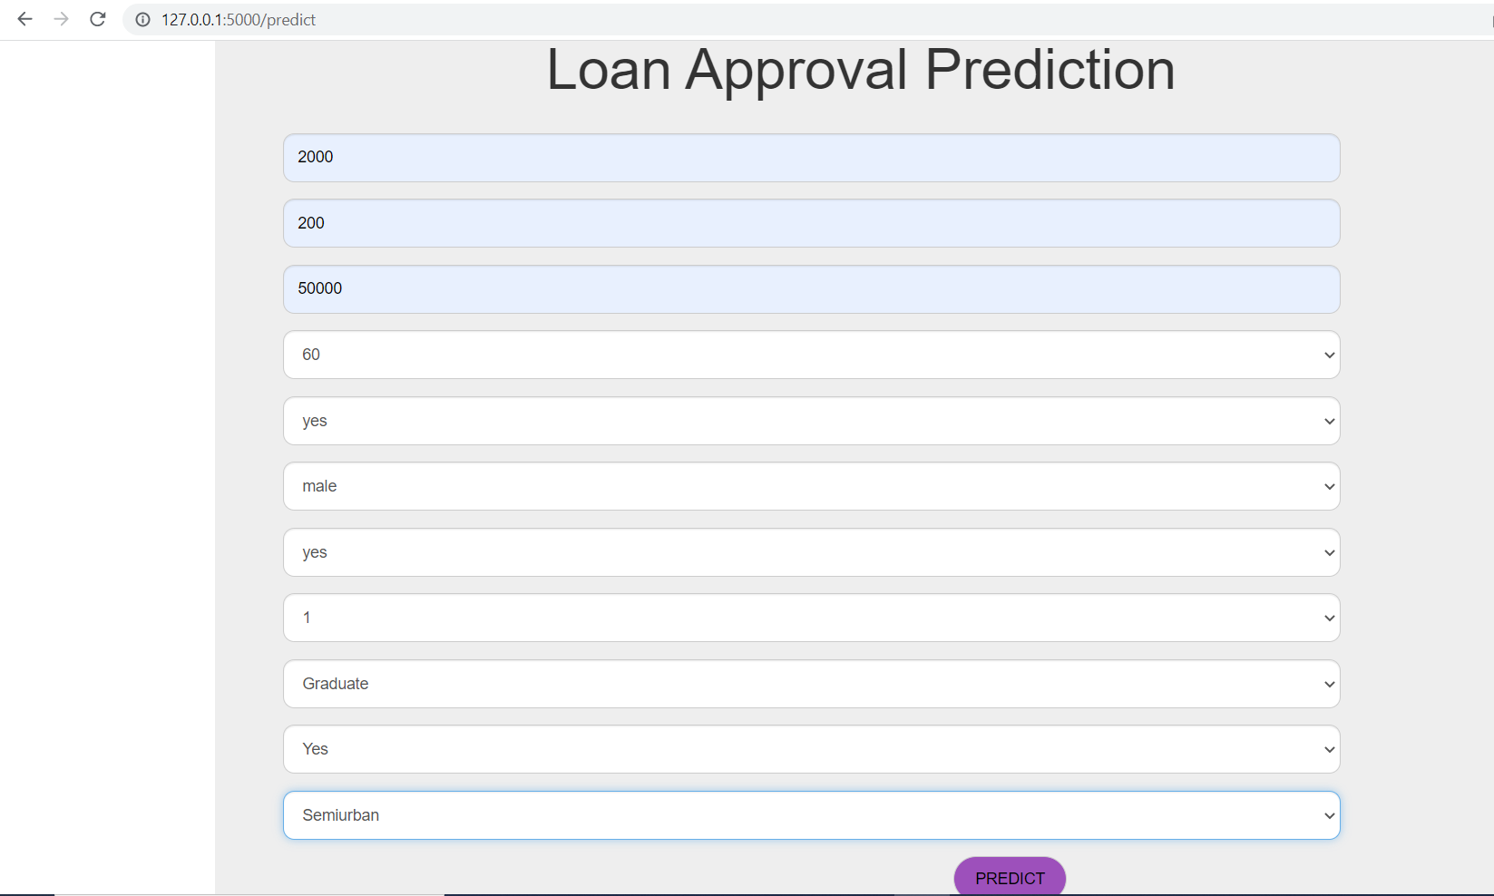
SVC MODEL DEPOLYMENT

Slide 27

MODELING OUTPUT
THIS IS THE OUTPUT AFTER WE PRESS THE PREDICT BUTTON

Slide 28
CONCLUSION
So here, it can be concluded with accuracy of Support vector machine model is extremely efficient and gives a better result when compared with Logistic Regression model. It works correctly and fulfills all the requirements of bankers. This system properly and accurately calculates the result. It predicts the loan is approved or reject to loan applicant or customer very accurately.

Slide 29

IEEE RESEARCH PAPER REFFERED
https://ieeexplore.ieee.org/stamp/stamp.jsp?tp=&arnumber=9498475
The main objective of this paper is to predict whether a new applicant granted the loan or not. The historical data of candidates was used to build a machine learning model. A Bank's profit and loss depend on the amount of loans that is whether the Client or customer is paying back the loan.
https://ieeexplore.ieee.org/stamp/stamp.jsp?tp=&arnumber=9742800
Estimating the risk involved in a loan application is one of the most crucial challenges for banks. In this study, Machine Learning algorithms are used to extract patterns from a common loan-approved dataset. Customers' past data such as their age, income, loan amount, and tenure of work will be used to conduct the analysis.

Slide 30

IEEE RESEARCH PAPER REFFERED
https://ieeexplore.ieee.org/stamp/stamp.jsp?tp=&arnumber=9336801
The number of applications is increasing every day for loan approval. It is tough and risky to check out manually every person and then recommended for loan approval. In this work, we use a machine learning technique that will predict who is reliable for a loan.
https://ieeexplore.ieee.org/stamp/stamp.jsp?tp=&arnumber=9675505
Advance loaning has been assumed a critical part in the monetary world consistently. It conveys an incredible danger, which in the space of advance loaning is alluded to as Credit hazard. This examination audits the current models anticipating hazard appraisal that utilization AI calculations.

Slide 31

IEEE RESEARCH PAPER REFFERED
https://ieeexplore.ieee.org/stamp/stamp.jsp?tp=&arnumber=9803172
The loan approval process is one of the most tedious task in the banking industry. Modern technology such as machine learning models can improve the speed, efficacy, and accuracy of loan approval processes. The models were trained on the historical dataset 'Loan Eligible Dataset,' available on Kaggle.
https://ieeexplore.ieee.org/stamp/stamp.jsp?tp=&arnumber=9155614
A bank's profit or a loss depends to a large extent on loans i.e. whether the customers are paying back the loan or defaulting. By predicting the loan defaulters, the bank can reduce its NonPerforming Assets. Using a logistic regression approach, the right customers to be targeted for loan can be easily detected.

Slide 32

IEEE RESEARCH PAPER REFFERED
https://www.irjet.net/archives/V8/i4/IRJET-V8I4785.pdf
A bank's profit or a loss depends to a large extent on loans i.e. whether the customers are paying back the loan or defaulting. By predicting the loan defaulters, the bank can reduce its Non-performing Assets (NPA). This makes the study of this phenomenon very important.
https://www.semanticscholar.org/paper/Modern-Approach-for-Loan-Sanctioning-in-Banks-Using-Rath-Das/b9a549f9014d8da0853fd284a53351cc7950f976
As the needs of people are increasing, the demand for loans in banks is also frequently getting higher every day. Usually, banks process the loan of any applicant after the verification and checking of its eligibility. In some cases, some applicants default in payment resulting in loss of capital in banks.

Slide 33
THANKYOU

